Slide 1
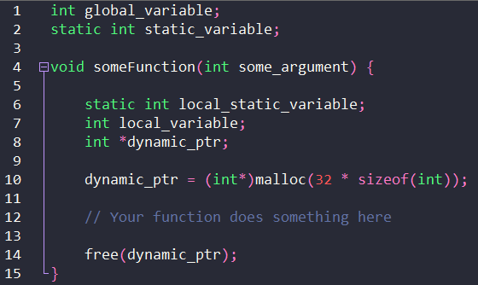
Memory Allocation
RAM
Stack
Automatic allocation
Static allocation
Heap
Dynamic allocation
Static

Slide 2
RTOS Memory Allocation
RAM
Task 2
Stack
Stack 2
xTaskCreate()
TCB 2
Heap
Task 1
Kernel Object 1
Stack 1
xTaskCreate()
Task 2
Task 1
TCB 1
Static
xTaskCreateStatic()
#define configSUPPORT_STATIC_ALLOCATION 1

Slide 3
Challenge: Pass a Message
Task A
Listens for input from Serial Monitor
On newline char (‘\n’), stores all chars up to that point in heap memory
Notifies Task B of new message
Task B
Waits for notification from Task A
Prints message found in heap memory to Serial Monitor
Frees heap memory

